Slide 1

What is API Gateway ?
An API Gateway acts as a central server that sits between clients (e.g., browsers, mobile apps) and backend services.
Instead of clients interacting with multiple microservices directly, they send their requests to the API Gateway. The gateway processes these requests, enforces security, and forwards them to the appropriate microservices.
An API gateway acts as a reverse proxy, sitting between clients (such as web or mobile applications) and backend services (your APIs).
It provides a centralized entry point for all API requests, allowing you to handle authentication, rate limiting, logging, and other cross-cutting concerns in a consistent manner.
Essentially, it’s the gatekeeper that ensures smooth communication between clients and your various APIs.

Slide 2
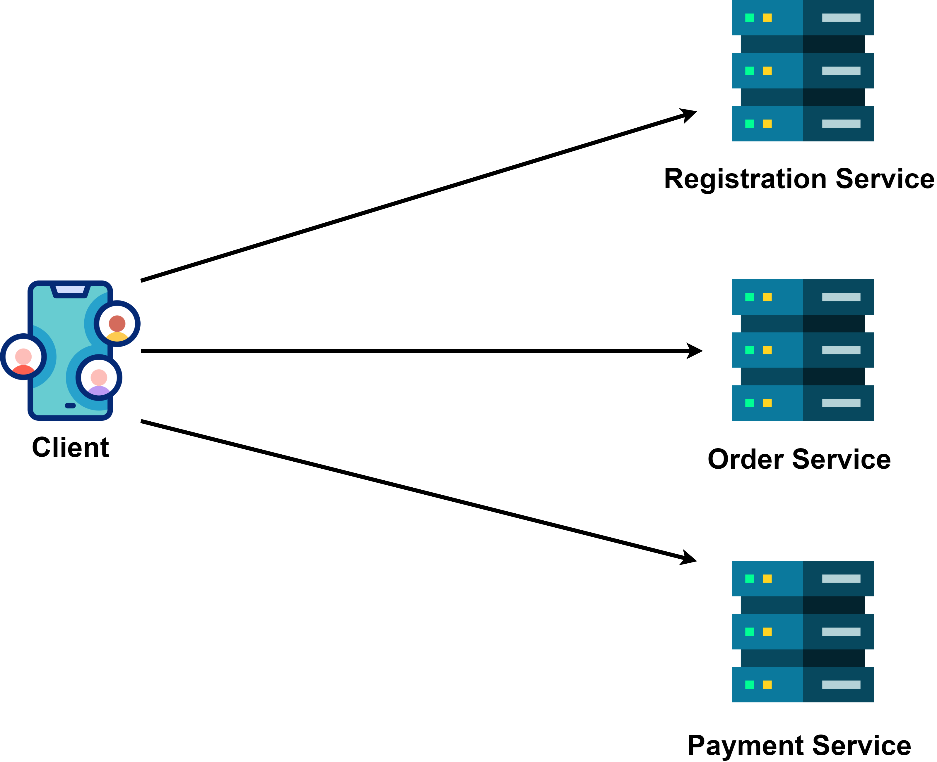
Why Do we need an API Gateway ?
Modern applications, especially those built using microservices architecture, have multiple backend services managing different functionalities.
For example, in an e-commerce service:
One service handles user Registration.
Another handles order.
Another manages payment services.
Without an API Gateway:
Clients would need to know the location and details of all backend services.
Developers would need to manage authentication, rate limiting, and security for each service individually.

Slide 3
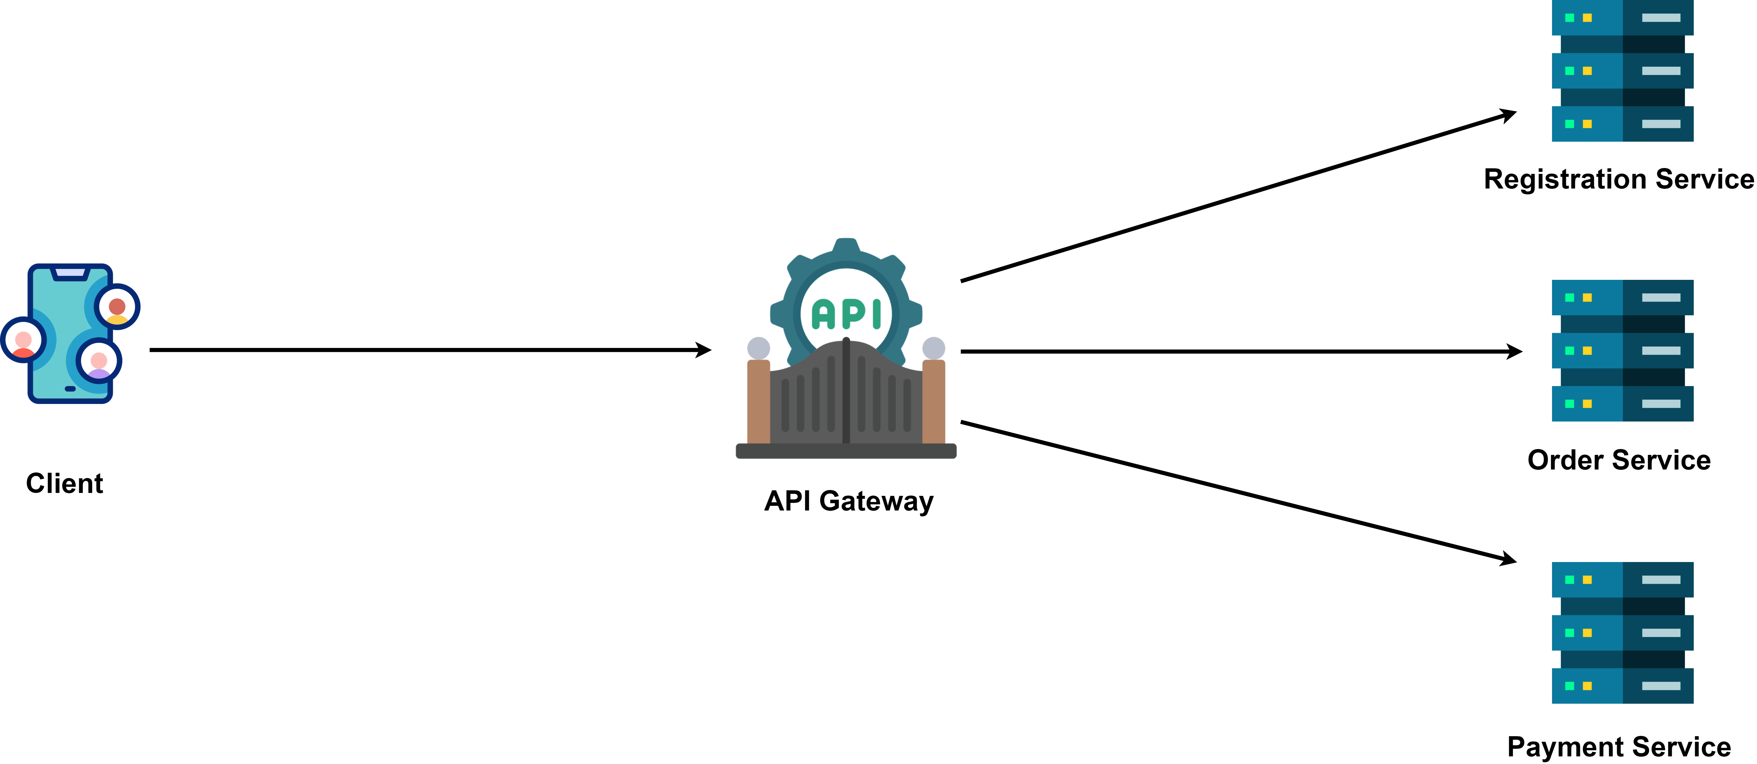
Why Do we need an API Gateway ?
With an API Gateway:
Clients send all requests to one place – the API Gateway.
The API Gateway takes care of routing, authentication, security, and other operational tasks, simplifying both client interactions and backend management.

Slide 4
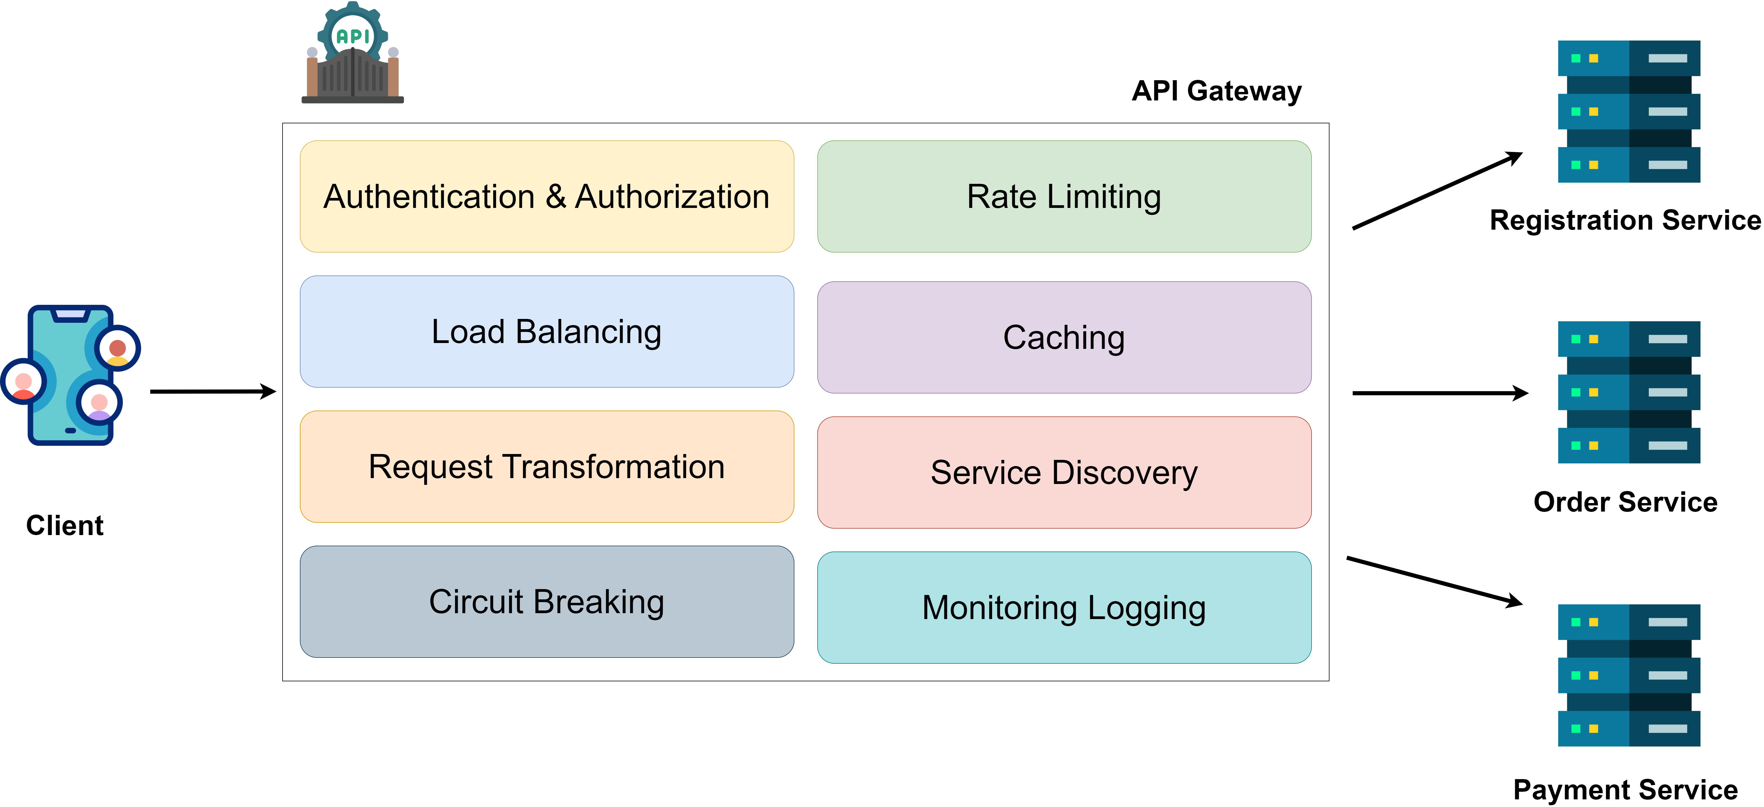
Why Do we need an API Gateway ?
Authentication and Authorization: API Gateway secures the backend systems by ensuring only authorized users and clients can access backend services.
Rate Limiting: To prevent abuse and ensure fair usage of
resources, most API Gateways implement rate limiting
Load Balancing: High-traffic applications rely
on load balancing to distribute incoming requests
evenly across multiple instances of a service.
Caching: To improve response times and reduce the strain on backend services, most API Gateways provide caching.

Slide 5
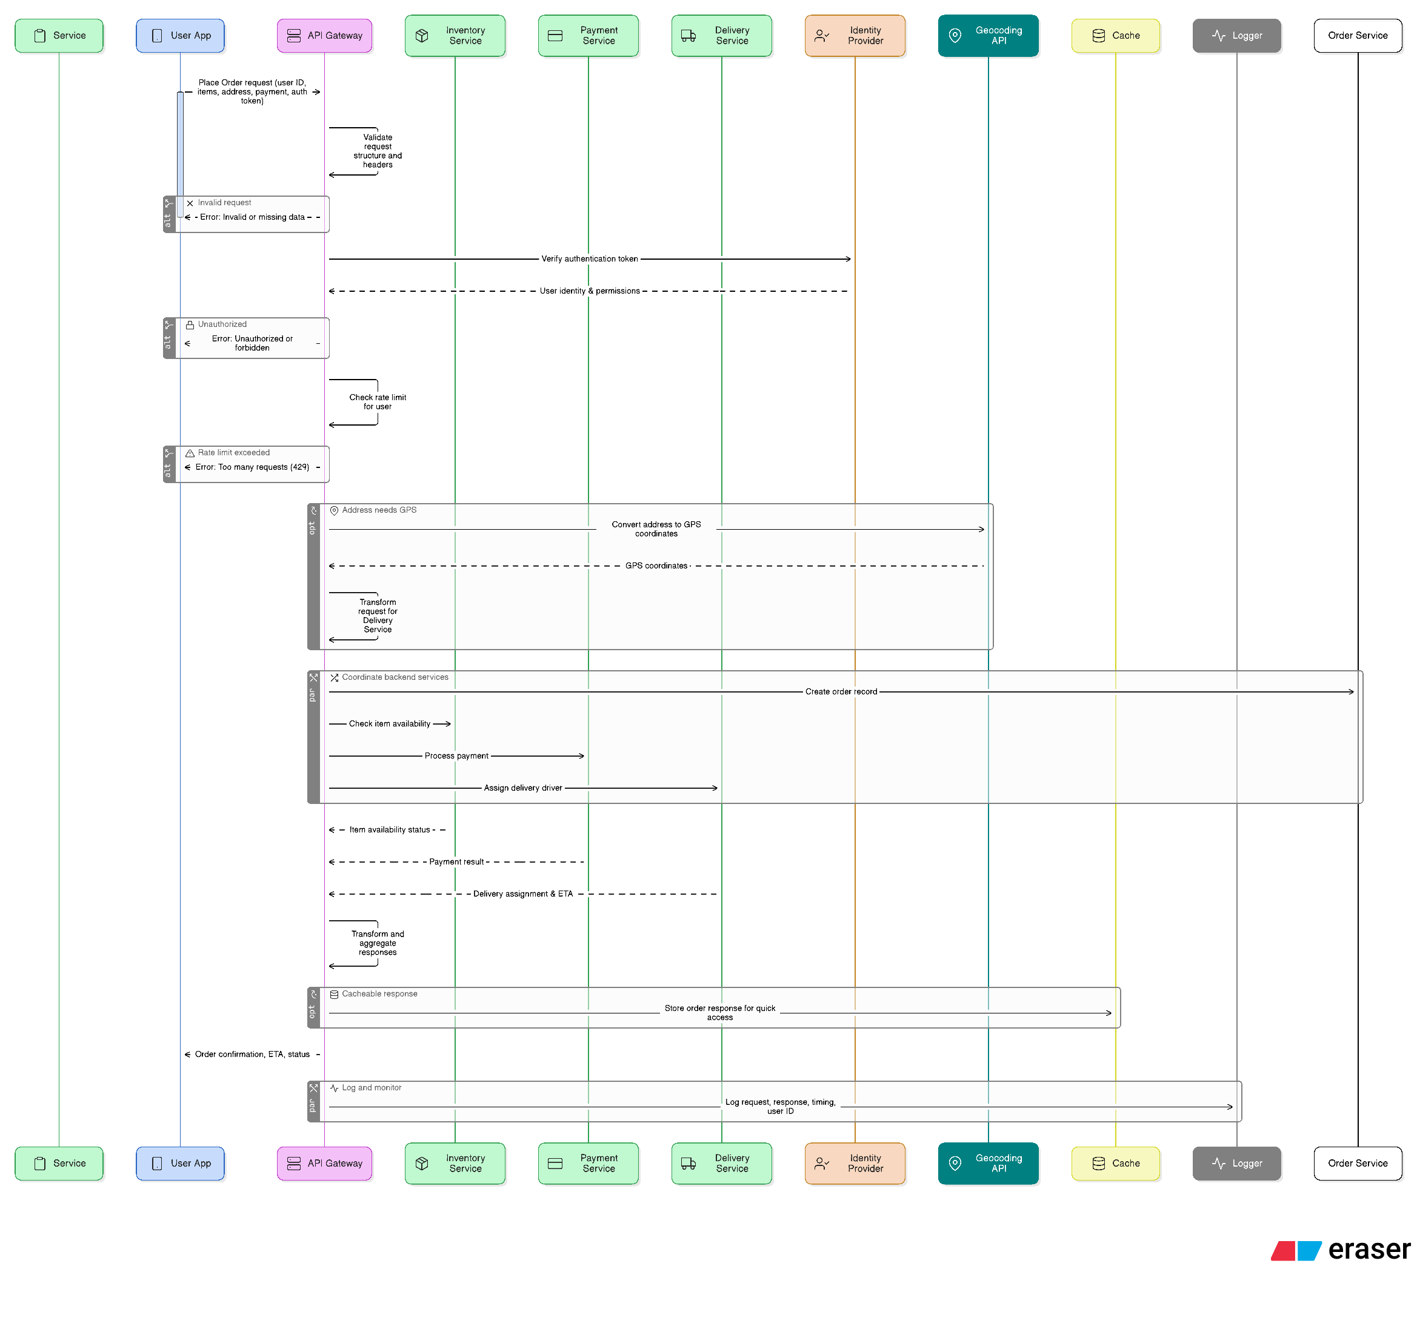
API Gateway Sequence Diagram?

Slide 6
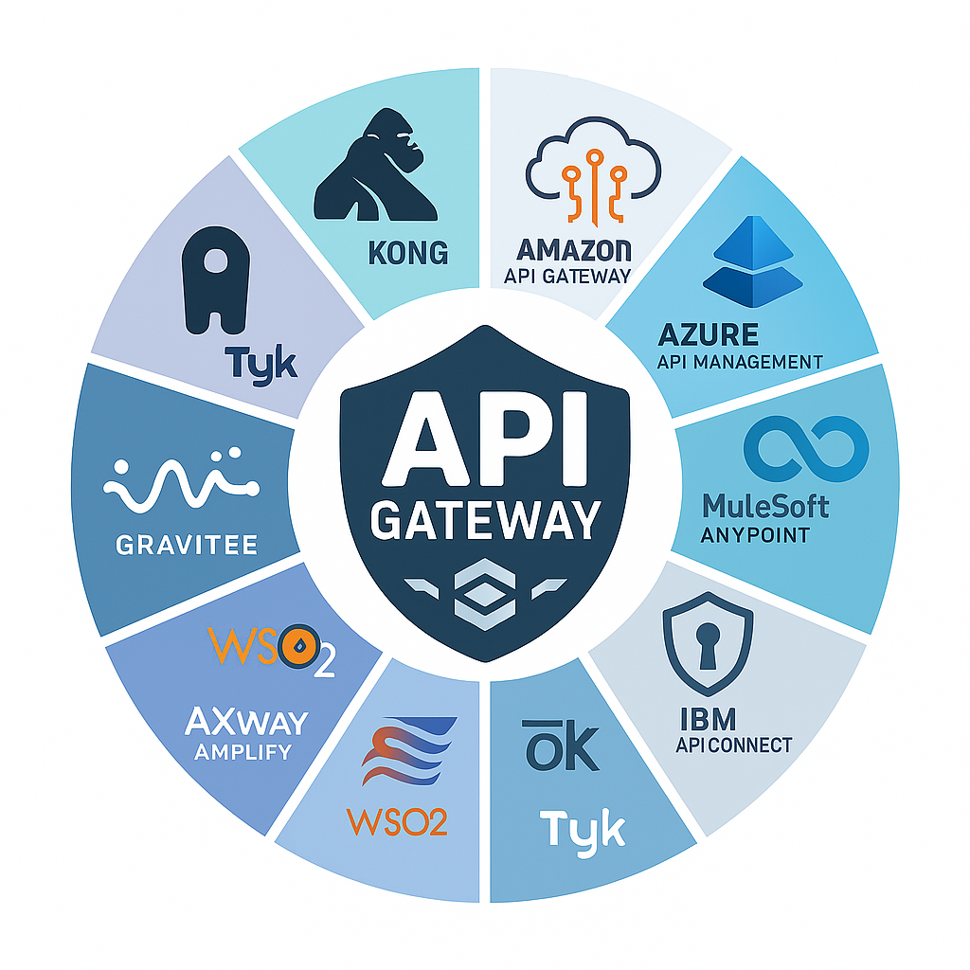
Why Do we need an API Gateway ?
Request Transformation: In systems with diverse clients and backend services, request transformation is essential for compatibility.
Service Discovery: Modern systems often involve microservices that scale dynamically. The service discovery feature of an API Gateway dynamically identifies the appropriate backend service instance to handle each request. This ensures seamless request routing even in environments where services frequently scale up or down.
Circuit Breaking: Circuit breaking is a mechanism that temporarily stops sending requests to a backend service when it detects persistent failures.
Logging and Monitoring: API Gateways provide robust monitoring and logging capabilities to track and analyze system behavior.

Slide 7
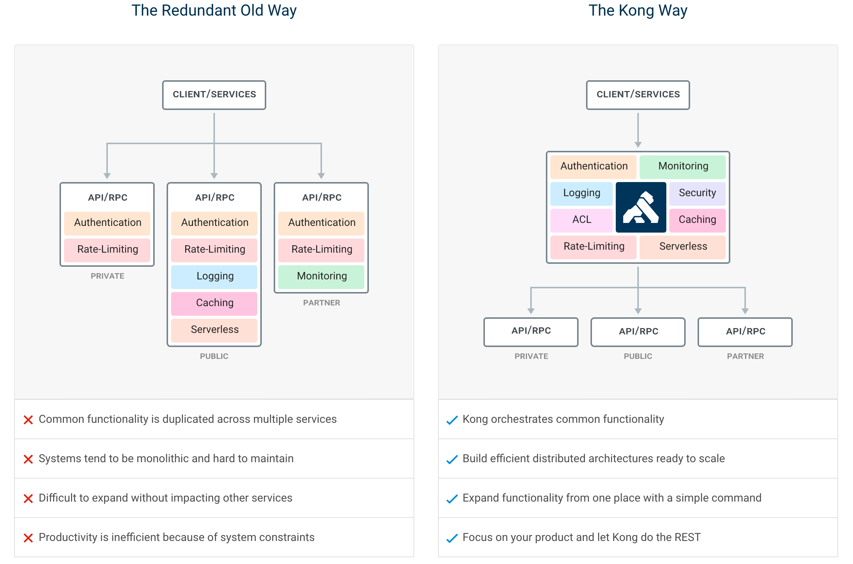

Slide 8
API Gateway Plugins
Authentication
Security
Traffic Control
Serverless
Add API key authentication to a service or a route.
Basic Authentication
HMAC Authentication
JWT
Key Authentication
LDAP Authentication
OAuth 2.0 Authentication
Session​
Enables security to protect API against unauthorized access.
ACME
Bot Detection
CORS
IP Restriction
Restrict inbound and outbound API traffic.
ACL
AI Prompt Guard
Proxy Caching
Rate Limiting
Request Size Limiting
Request Termination
Response Rate Limiting
Developers can conjure up code without worrying about the mundane chores of resource management and infrastructure.
AI Proxy
AWS Lambda
Azure Functions
Kong Functions(Post-Plugins)
Kong Functions (Pre-Plugins)

Slide 9
API Gateway Plugins
Analytics & Monitoring Plugin
Transformations
Logging
Monitor health of API
Datadog
OpenTelemetry
Prometheus
StatsD
Zipkin
Transform API request before they reach Upstream server
AI Prompt Decorator
AI Prompt Template
AI Request Transformer
AI Response Transformer
Correlation ID
gRPC Gateway
gRPC Web
Request Transformer
Response Transformer
Logging API Requests
File Log
HTTP Log
Loggly
Syslog
TCP Log
UPD Log

Slide 10
